Slide 1
Active learning and application to scientific computing
Jiaxi Zhao Dec 2021

Slide 2
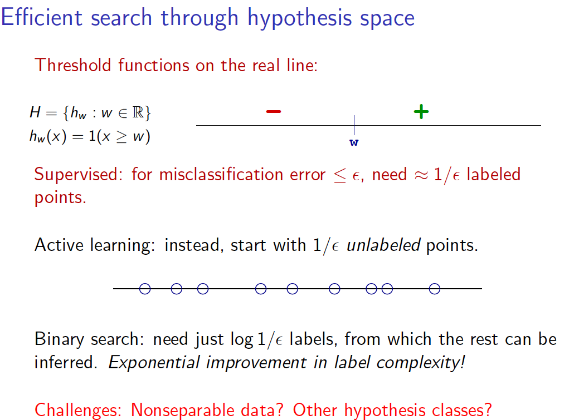
Heuristic Example

Slide 3
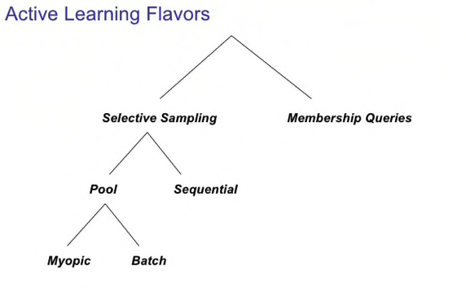
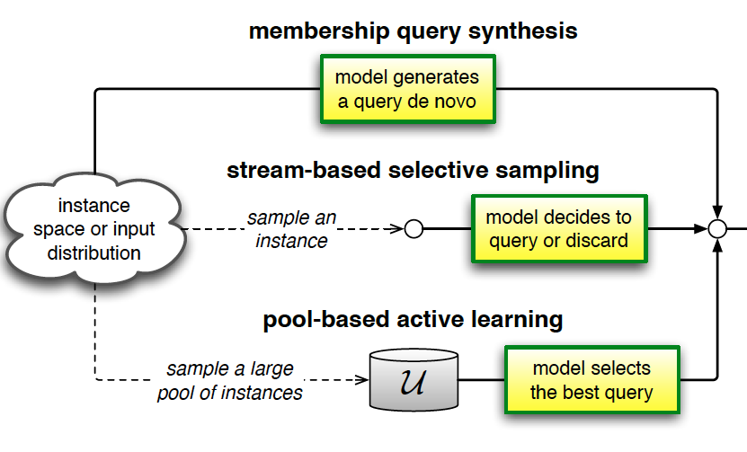
General framework of Active learning

Slide 4
Query Strategy:
Uncertainty Sampling
Query the event that the current classifier is most uncertain about
Needs measure of uncertainty, probabilistic model for prediction
Examples:
  Entropy
  Least confident predicted label
  Euclidean distance (e.g. point closest to margin in SVM)

Slide 5
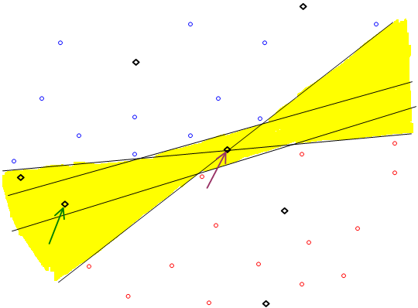
Query Strategy:
Query-By-Committee
Yellow = valid hypotheses

Slide 6
Query Strategy: Expected Model Change
Modeling the KL divergence of the posteriors measures the amount of information gain expected from query (where x’ is the queried data):
Goal: choose a query that maximizes the KL divergence between posterior and prior
Basic idea: largest KL divergence between updated posterior probability and the current posterior probability represents largest gain
D( p(θ | x, x’) || p(θ | x))

Slide 7


Query Strategy：
Variance Reduction and Fisher Information Ratio

Slide 8
Comparison
Empirical Comparison with Supervised Learning:
  It is the only method to be used in label-expensive setting
  It truly show better sample complexity
  It is not adaptive to model change
J. Baldridge and M. Osborne. Active learning and the total cost of annotation. In Proceedings of the Conference on Empirical Methods in Natural Language Processing (EMNLP), pages 9–16. ACL Press, 2004.

Slide 9
Application to Scientific computing
Labeled data is extremely expensive to obtain, due to time and money consumption, in some setting such as CT, each time of labeling may cause an irreversible damage to the data
We have enormous freedom to specify settings in scientific computing, i.e. IC & BC in PDE…

Slide 10
Application to Scientific computing
DeePMD & DeePGEN:
  Ab-initio calculation is extremely time-consuming
  Experiment such as Cryo-SEM is extremely expensive
  Query committee based active learning
Active learning of uniformly accurate interatomic potentials for materials simulationL Zhang, DY Lin, H Wang, R Car, E Weinan - Physical Review Materials, 2019

Slide 11
Application to Scientific computing
In addition, dense sampling of the chemical composition space is not always necessary. For example, the initial ANI training set of 20 million molecules could be replaced with 5.5 million training points selected using an active learning method that added poorly predicted molecular examples from each training cycle
Smith, J. S., B. Nebgen, N. Lubbers, O. Isayev, and A. E. Roitberg (2018), J. Chem. Phys. 148 (24), 241733.

Slide 12
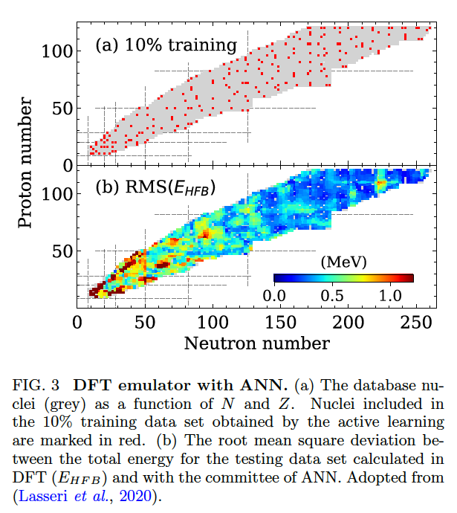
Application to Scientific computing
Boehnlein, Amber, et al. "Artificial Intelligence and Machine Learning in Nuclear Physics." arXiv preprint arXiv:2112.02309(2021).

Slide 13
Application to Scientific computing
CT

Slide 14
Further Reference:
    Settles, Burr. "Active learning literature survey." (2009).
    Carleo, Giuseppe, et al. "Machine learning and the physical sciences." Reviews of Modern Physics 91.4 (2019): 045002.
    http://people.eecs.berkeley.edu/~jordan/courses/294-fall09/
    https://hunch.net/~active_learning/active_learning_icml09.pdf

Slide 15
Thank you

